Slide 1

An Analysis of Oceanic Measurements & Marine Life
Group 11
Abdullah Albattal
Li-Yang Chang
Seyed Omid Hasanli
Yuchen Zhang

Slide 2
Motivation and Objective
Can our oceans tell us anything about global warming and climate change?
If yes, where and how is it present?
Does it affect biological footprint and marine lives?
Finally:
Does California experience similar repercussions or trends?

Slide 3
Dataset
NOAA ( National Centers for Environmental Information)
WOD (World Ocean Database ) – OSD (Ocean Station Data )
3.2 million Casts
250 Thousand Biological Casts
Data for ocean variables including temperature, salinity, pH, oxygen, etc.
ERDDAP (Environmental Research Divisions Data Access Program )
API based data query -
Coast watch
BCO-DMO (Biological & Chemistry Oceanography Data Management Office)
Data for jellyfish and zooplanktons

Slide 4
Methodology
Cast Reports Scrapping
Data Cleaning
Global Trends Analysis
Correlation Analysis
Biological Data Analysis
Local (California) Temperature Trends Analysis.

Slide 5
Methodology
Cast Report Scrapping
Data Cleaning
Exploratory Analysis
Californian Trends
Global Trends Analysis
Correlation Analysis
Biological Data Analysis

Slide 6
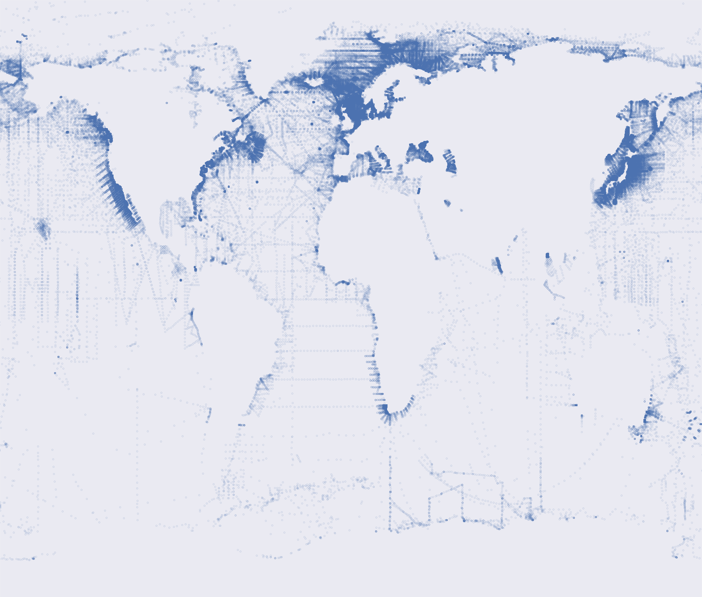
Measurements Locations of 1950 to 1959

Slide 7
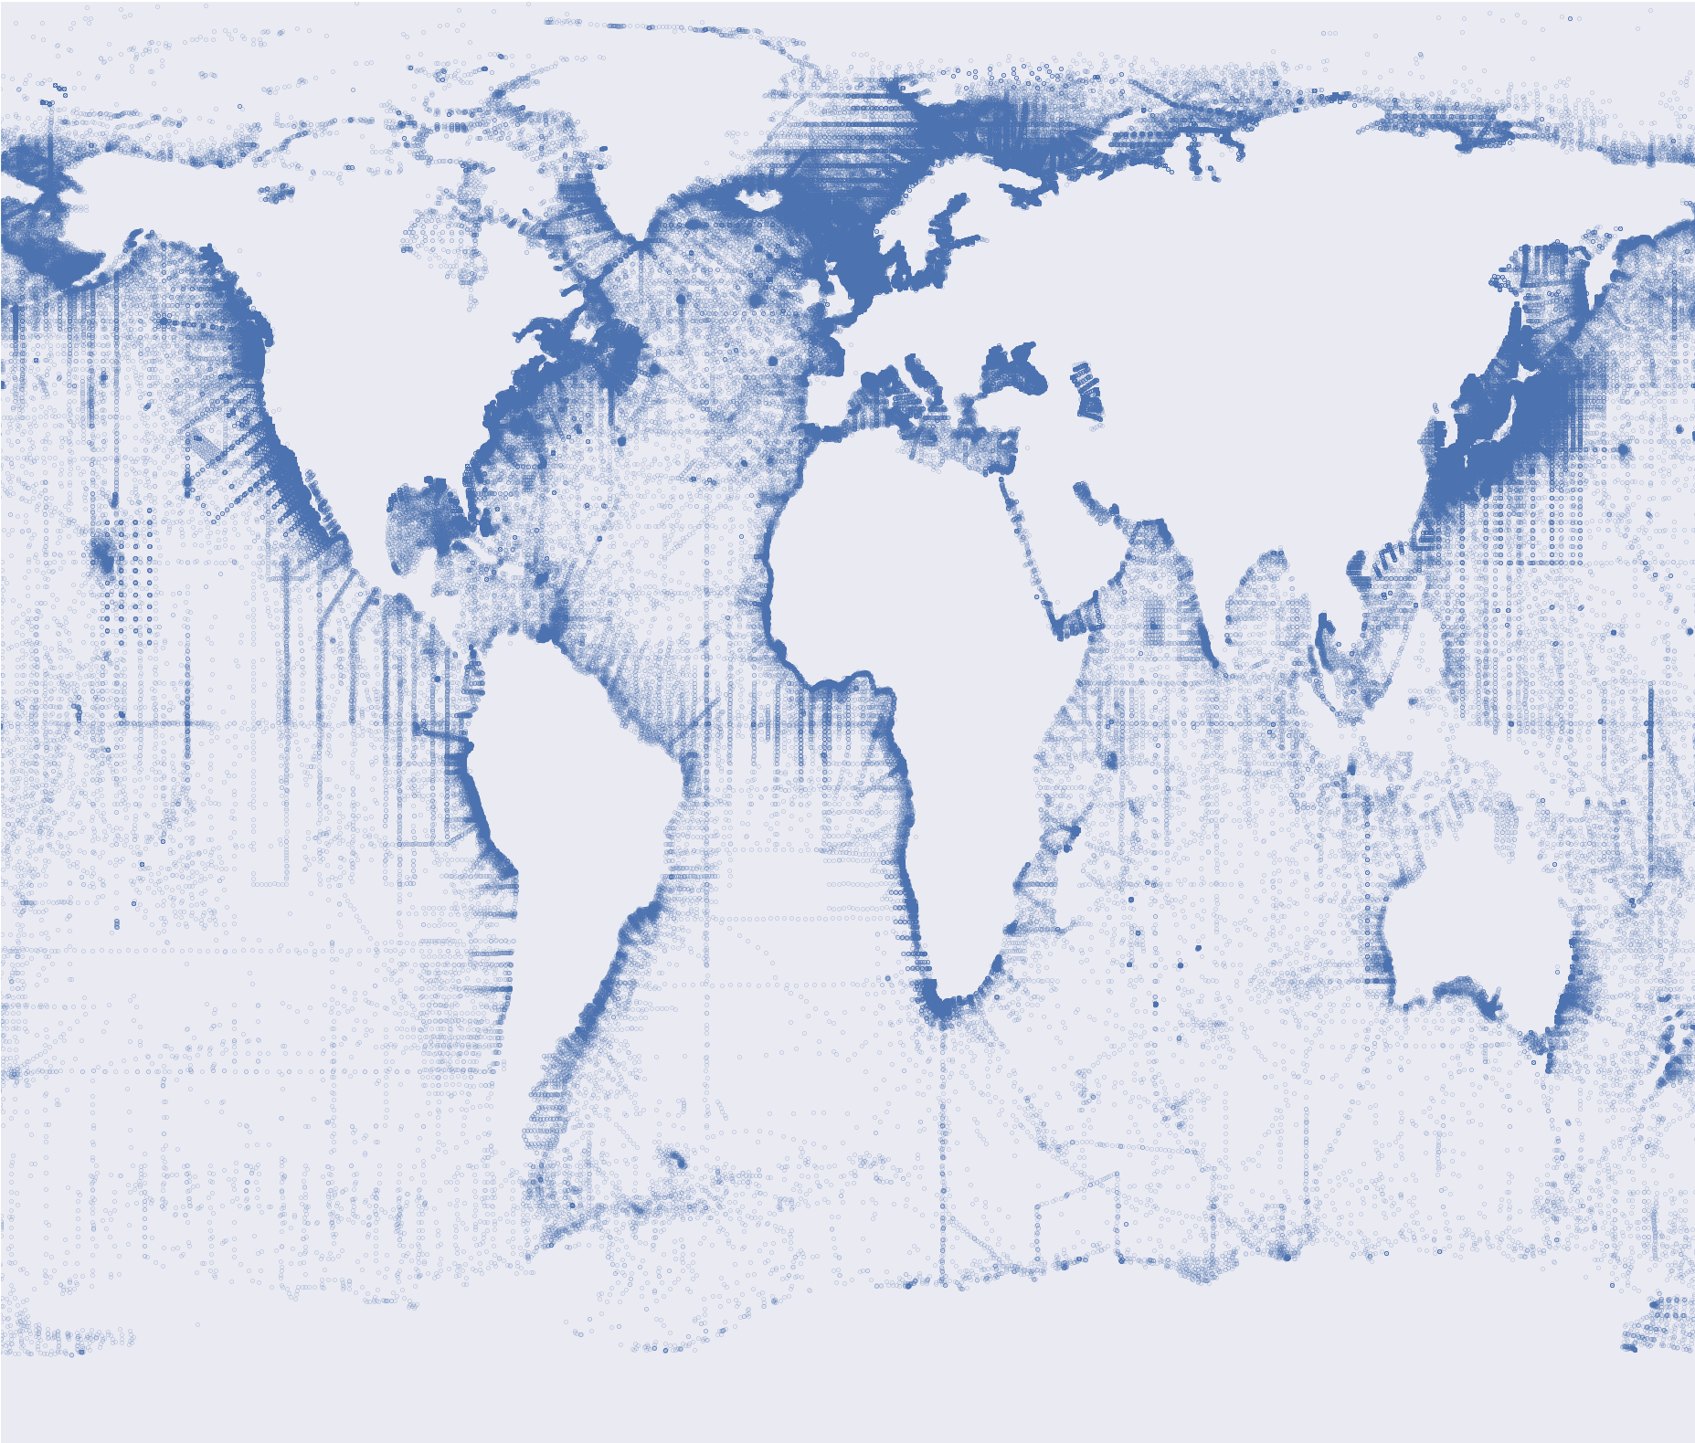
Measurements Locations of 1950 to 1969

Slide 8
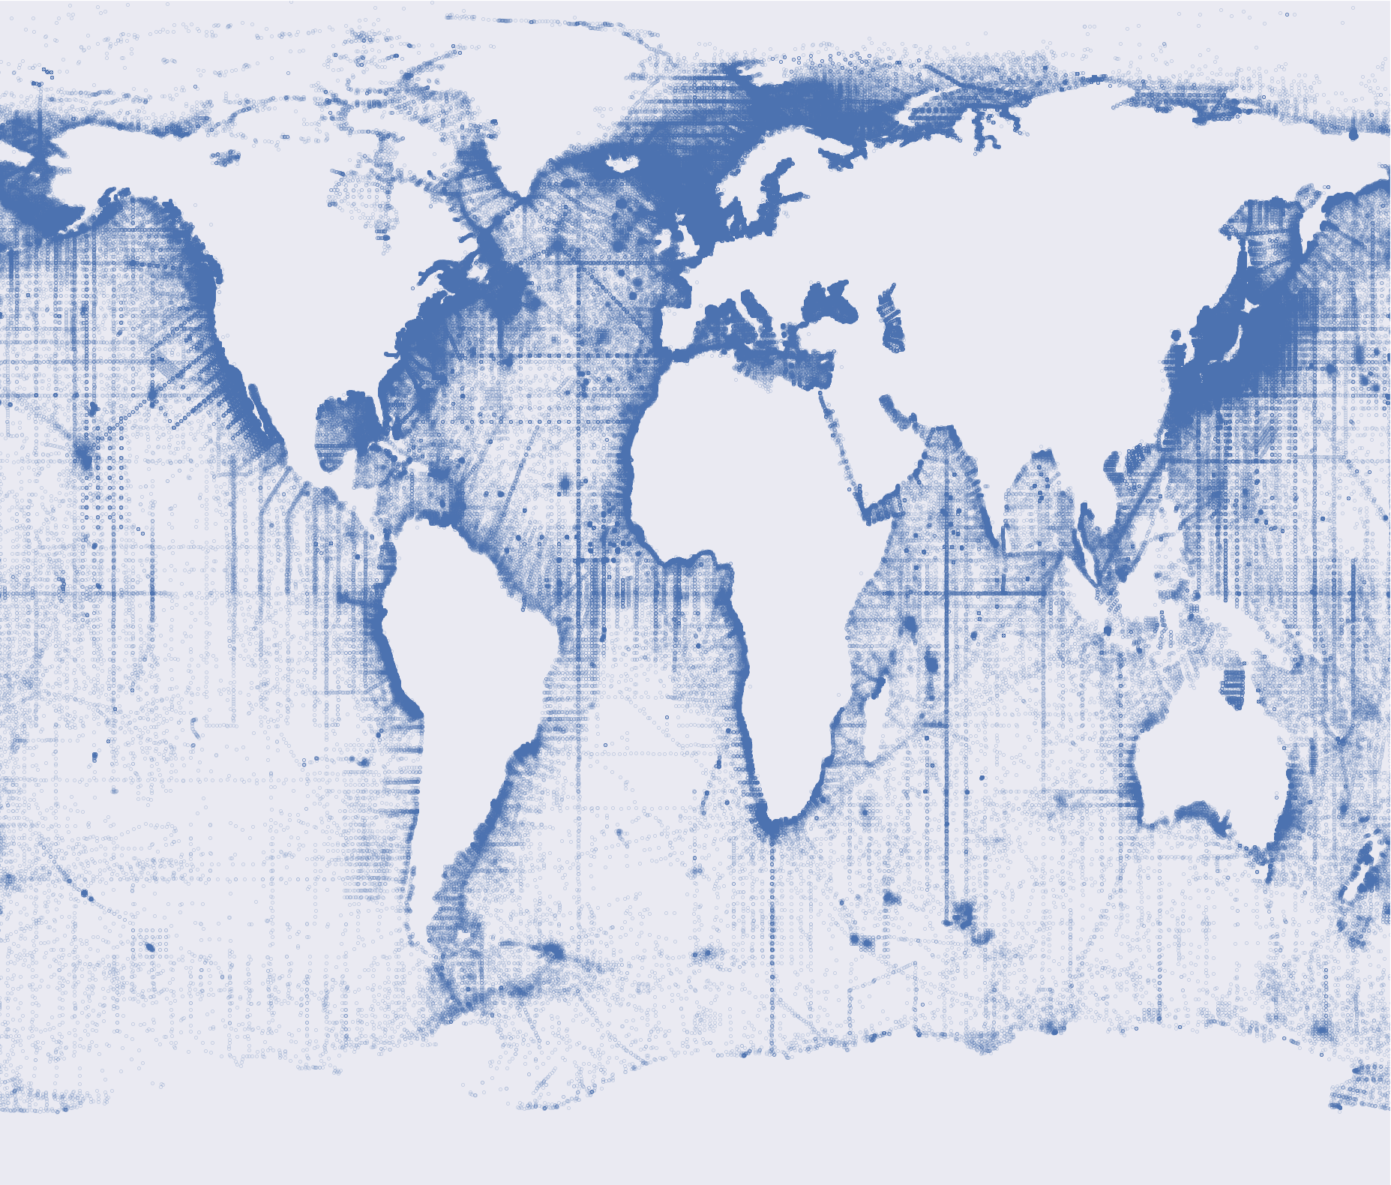
Measurements Locations of 1950 to 1979

Slide 9
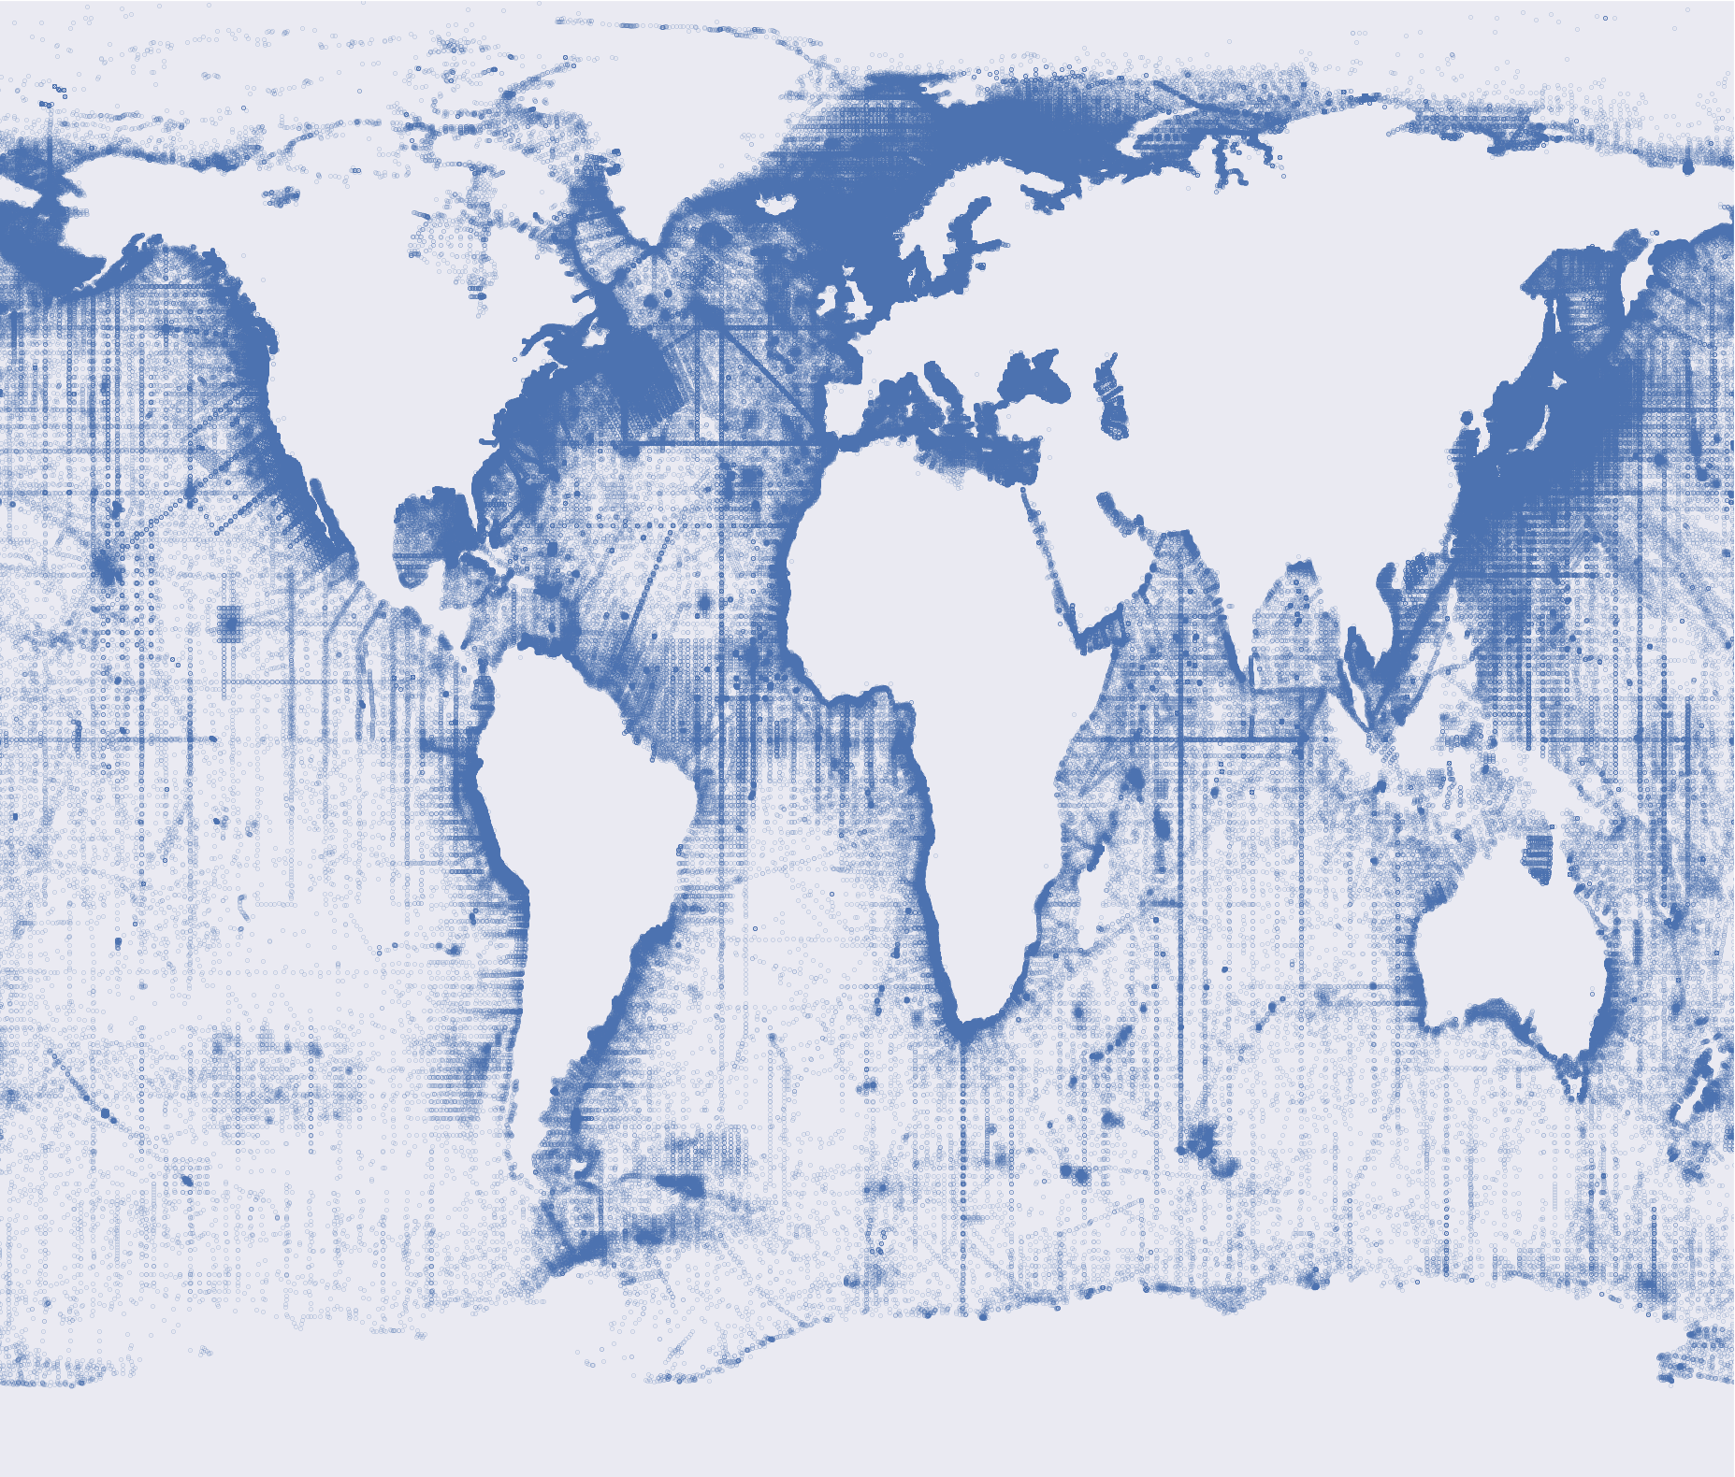
Measurements Locations of 1950 to 1989

Slide 10
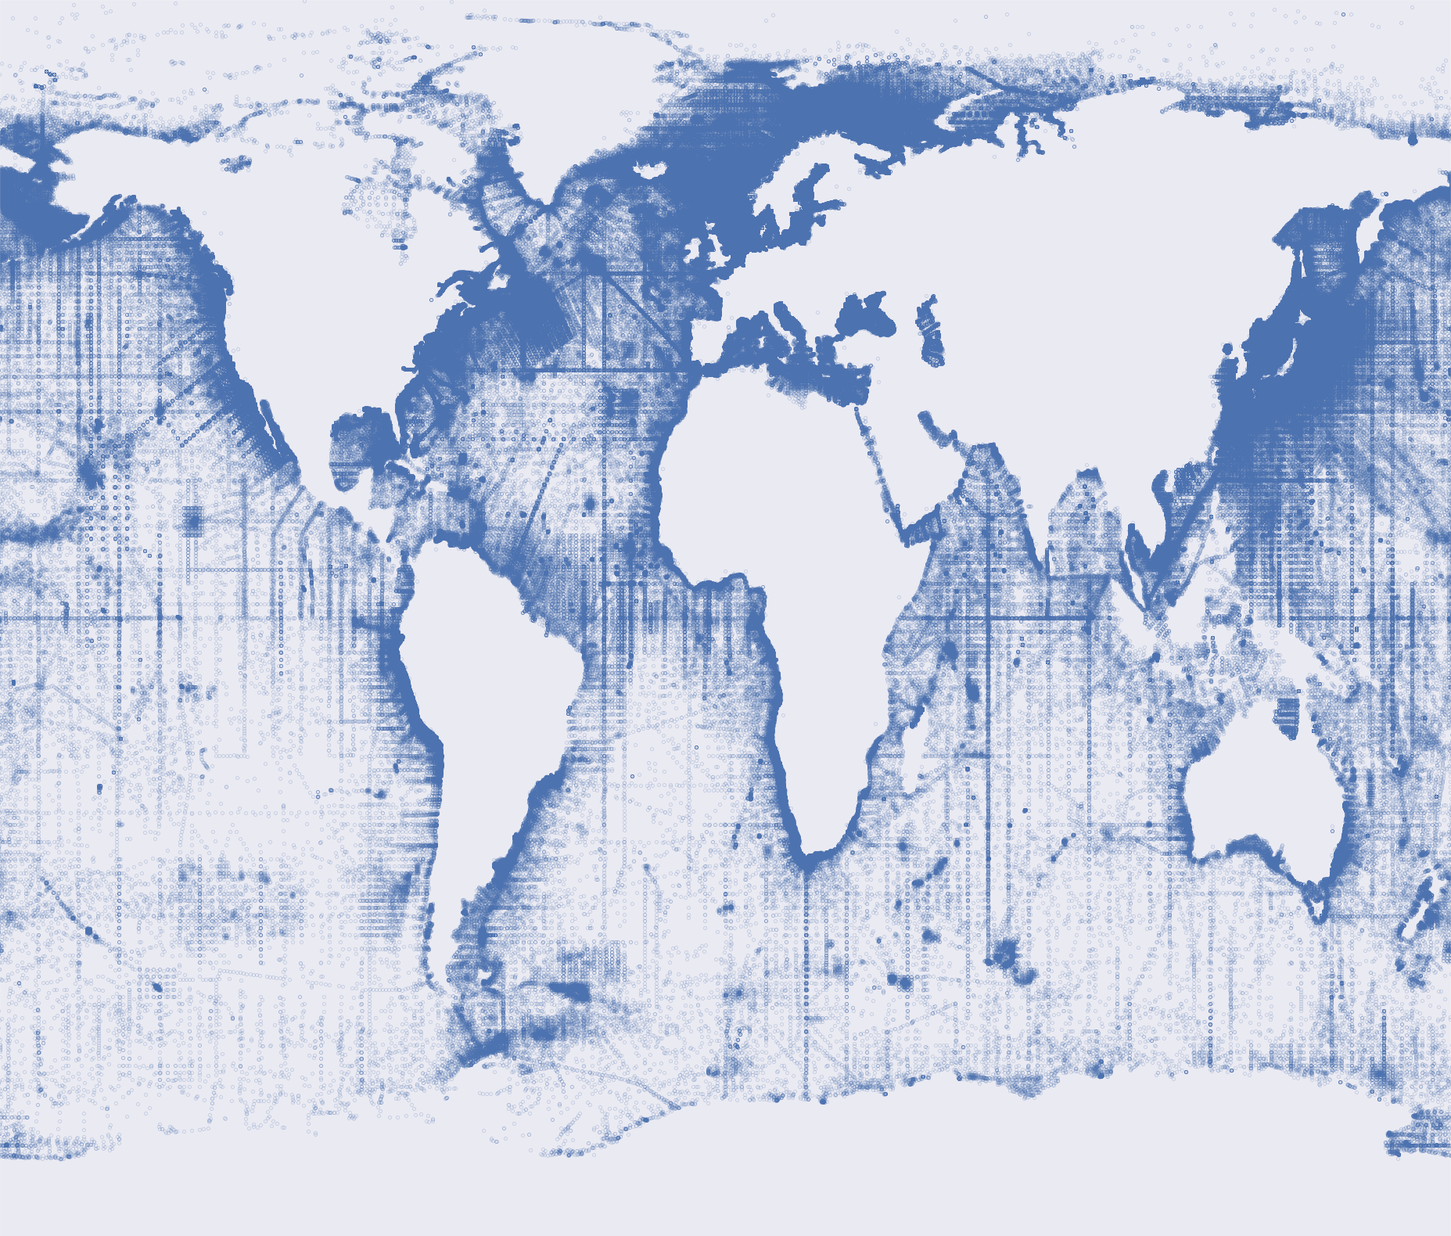
Measurements Locations of 1950 to 1999

Slide 11

Measurements Locations of 1950 to 2009

Slide 12

Measurements Locations of 1950 to 2018

Slide 13
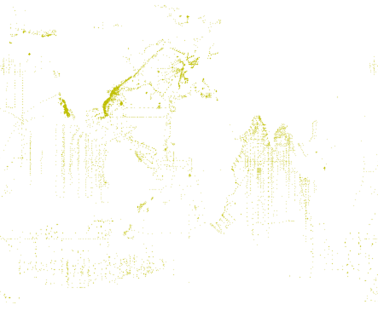
Measurements Locations with Jellyfish

Slide 14
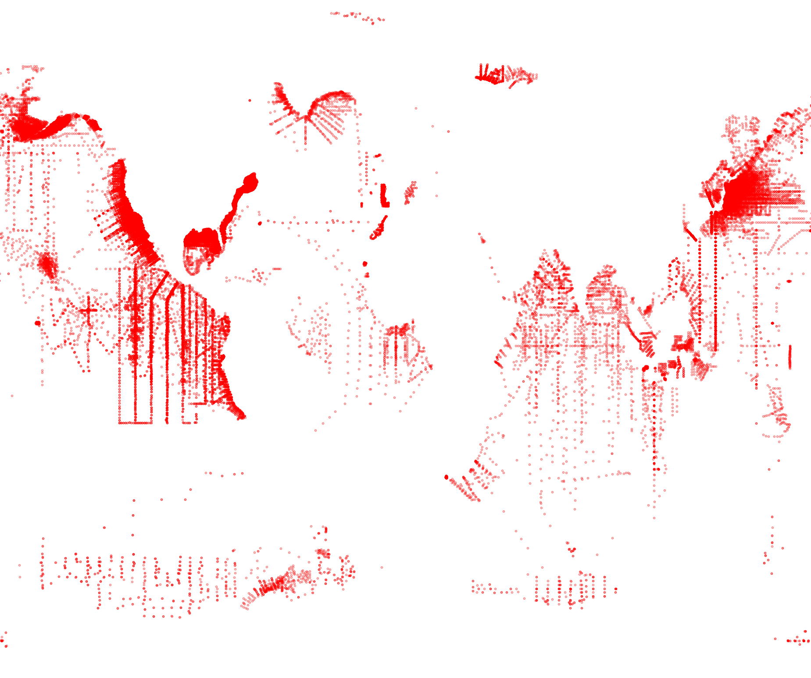
Measurements Locations with Plankton

Slide 15
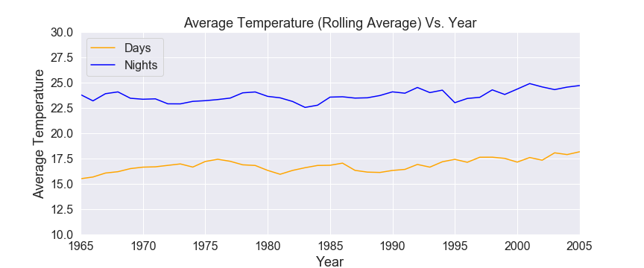
Global Temperature Trends

Slide 16
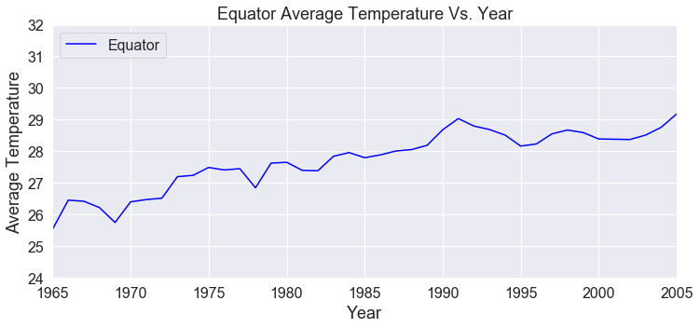
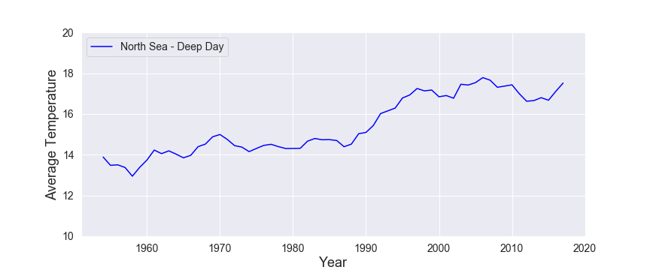

Slide 17
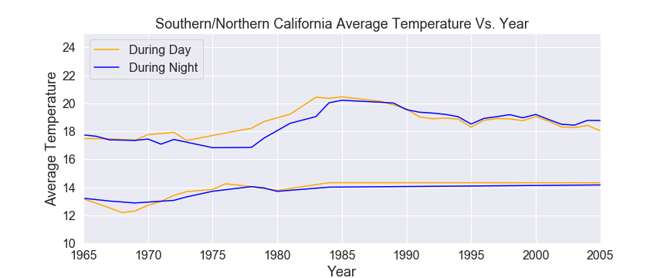
California Temperature Trends

Slide 18
Attributes
Temperature
Non-Biological Attributes
Oxygen
pH
Salinity
Nitrate
Phosphate
Biological Attributes
Plankton
Jelly Fish

Slide 19
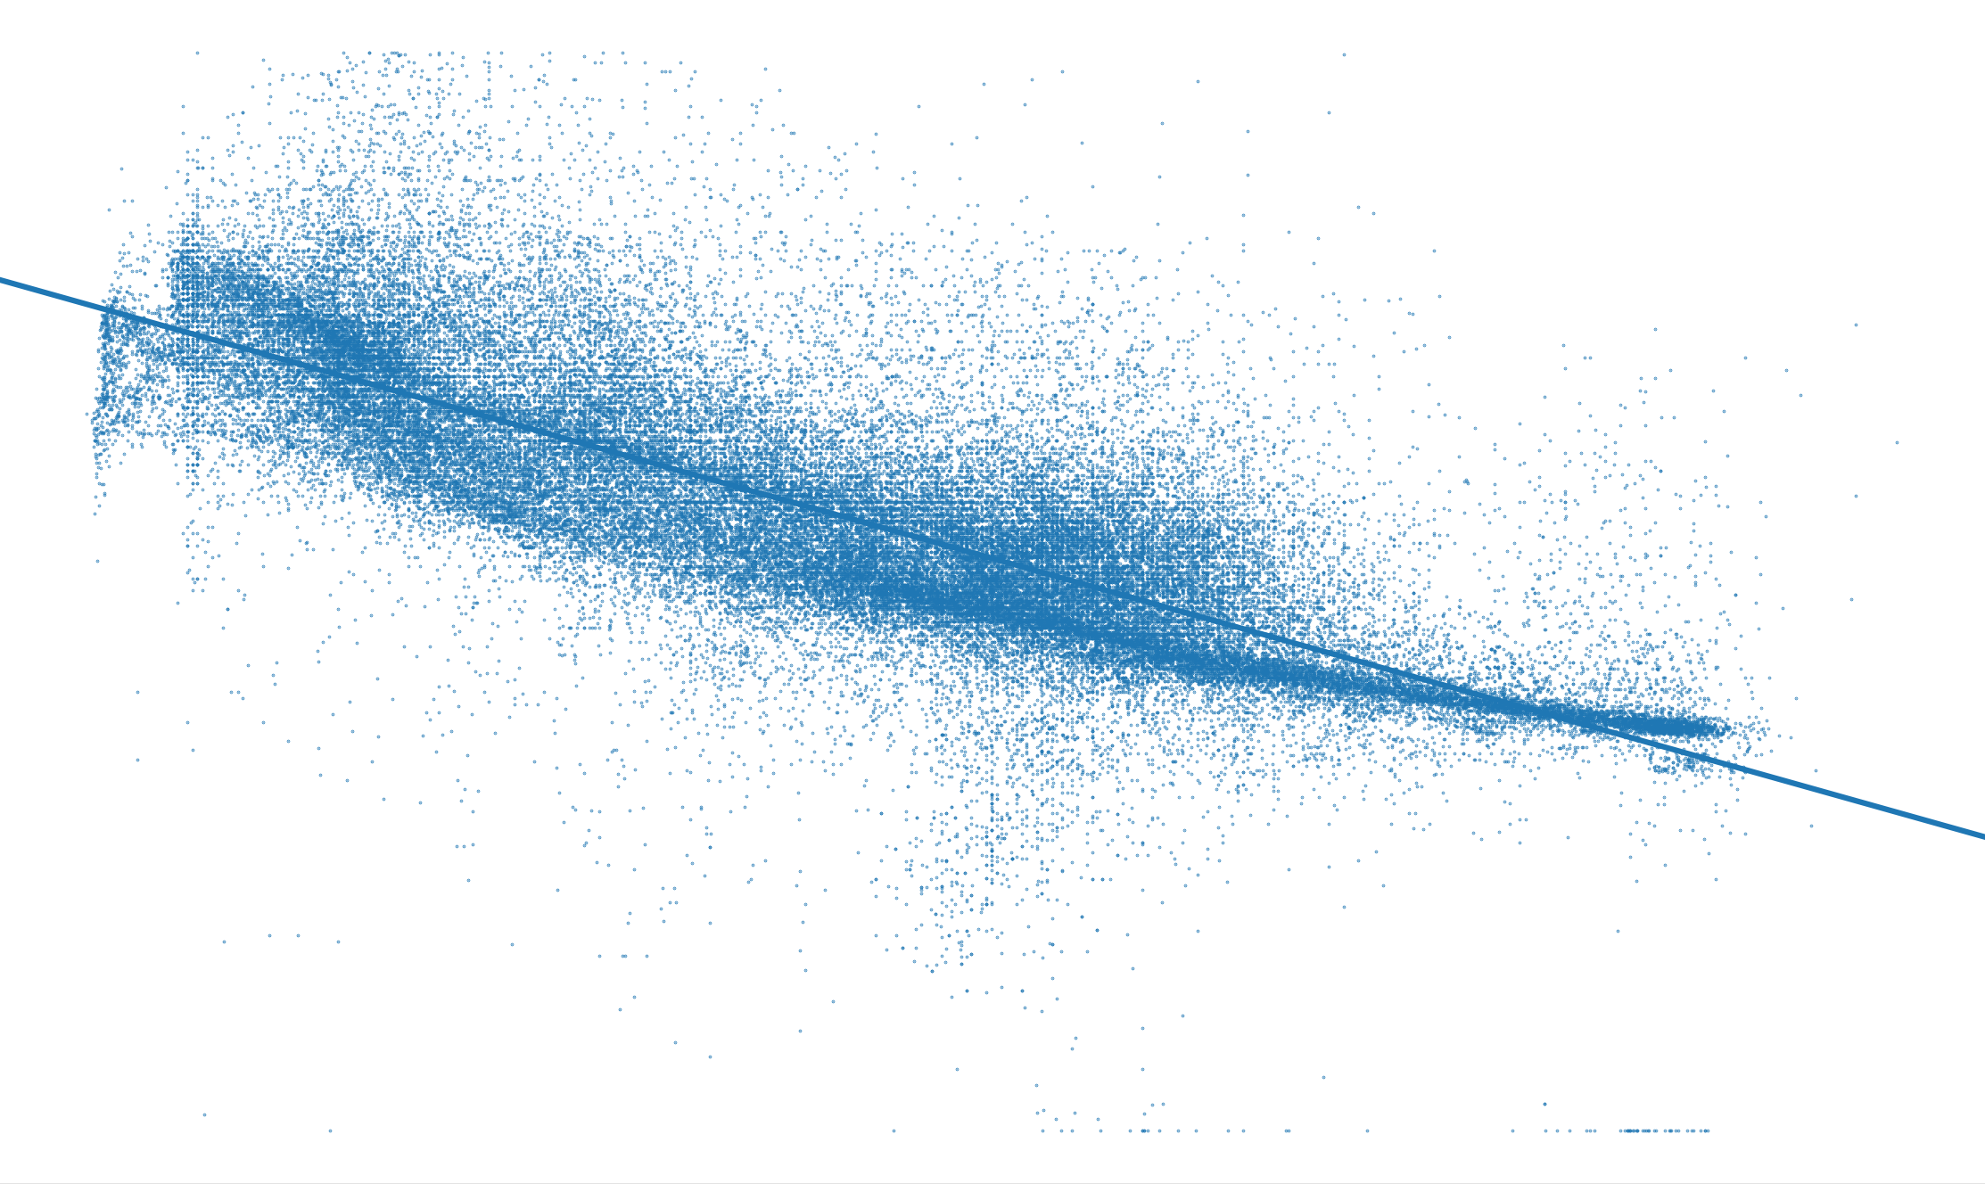
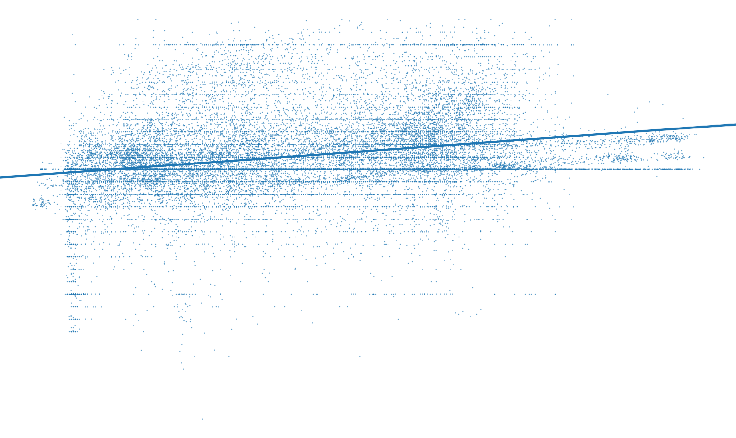
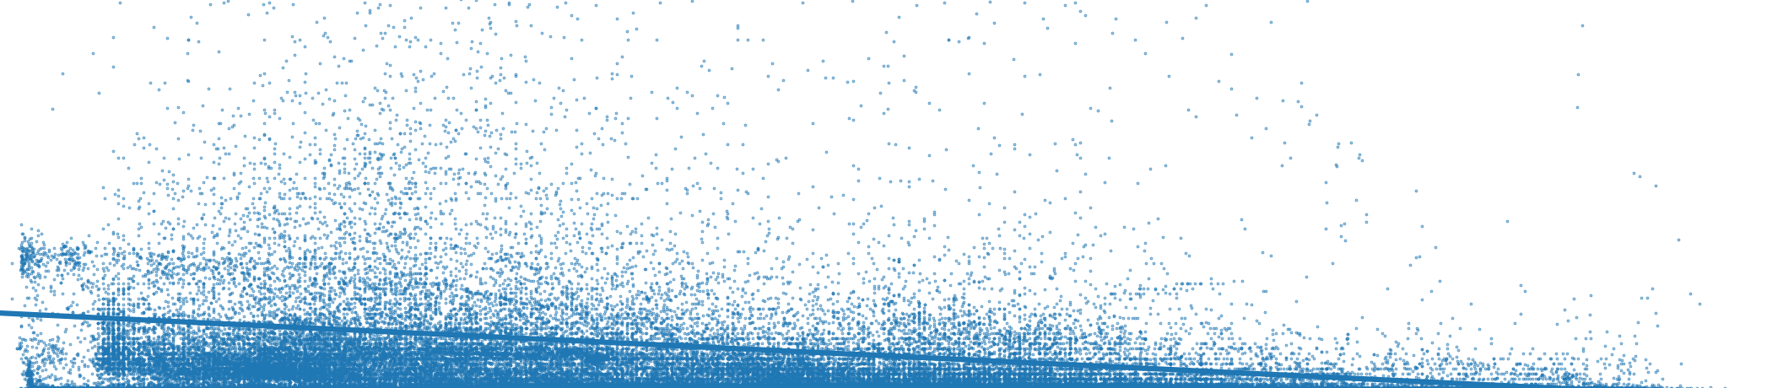

Oxygen
pH
Temperature
Temperature
Nitrate
Phosphate

Slide 20
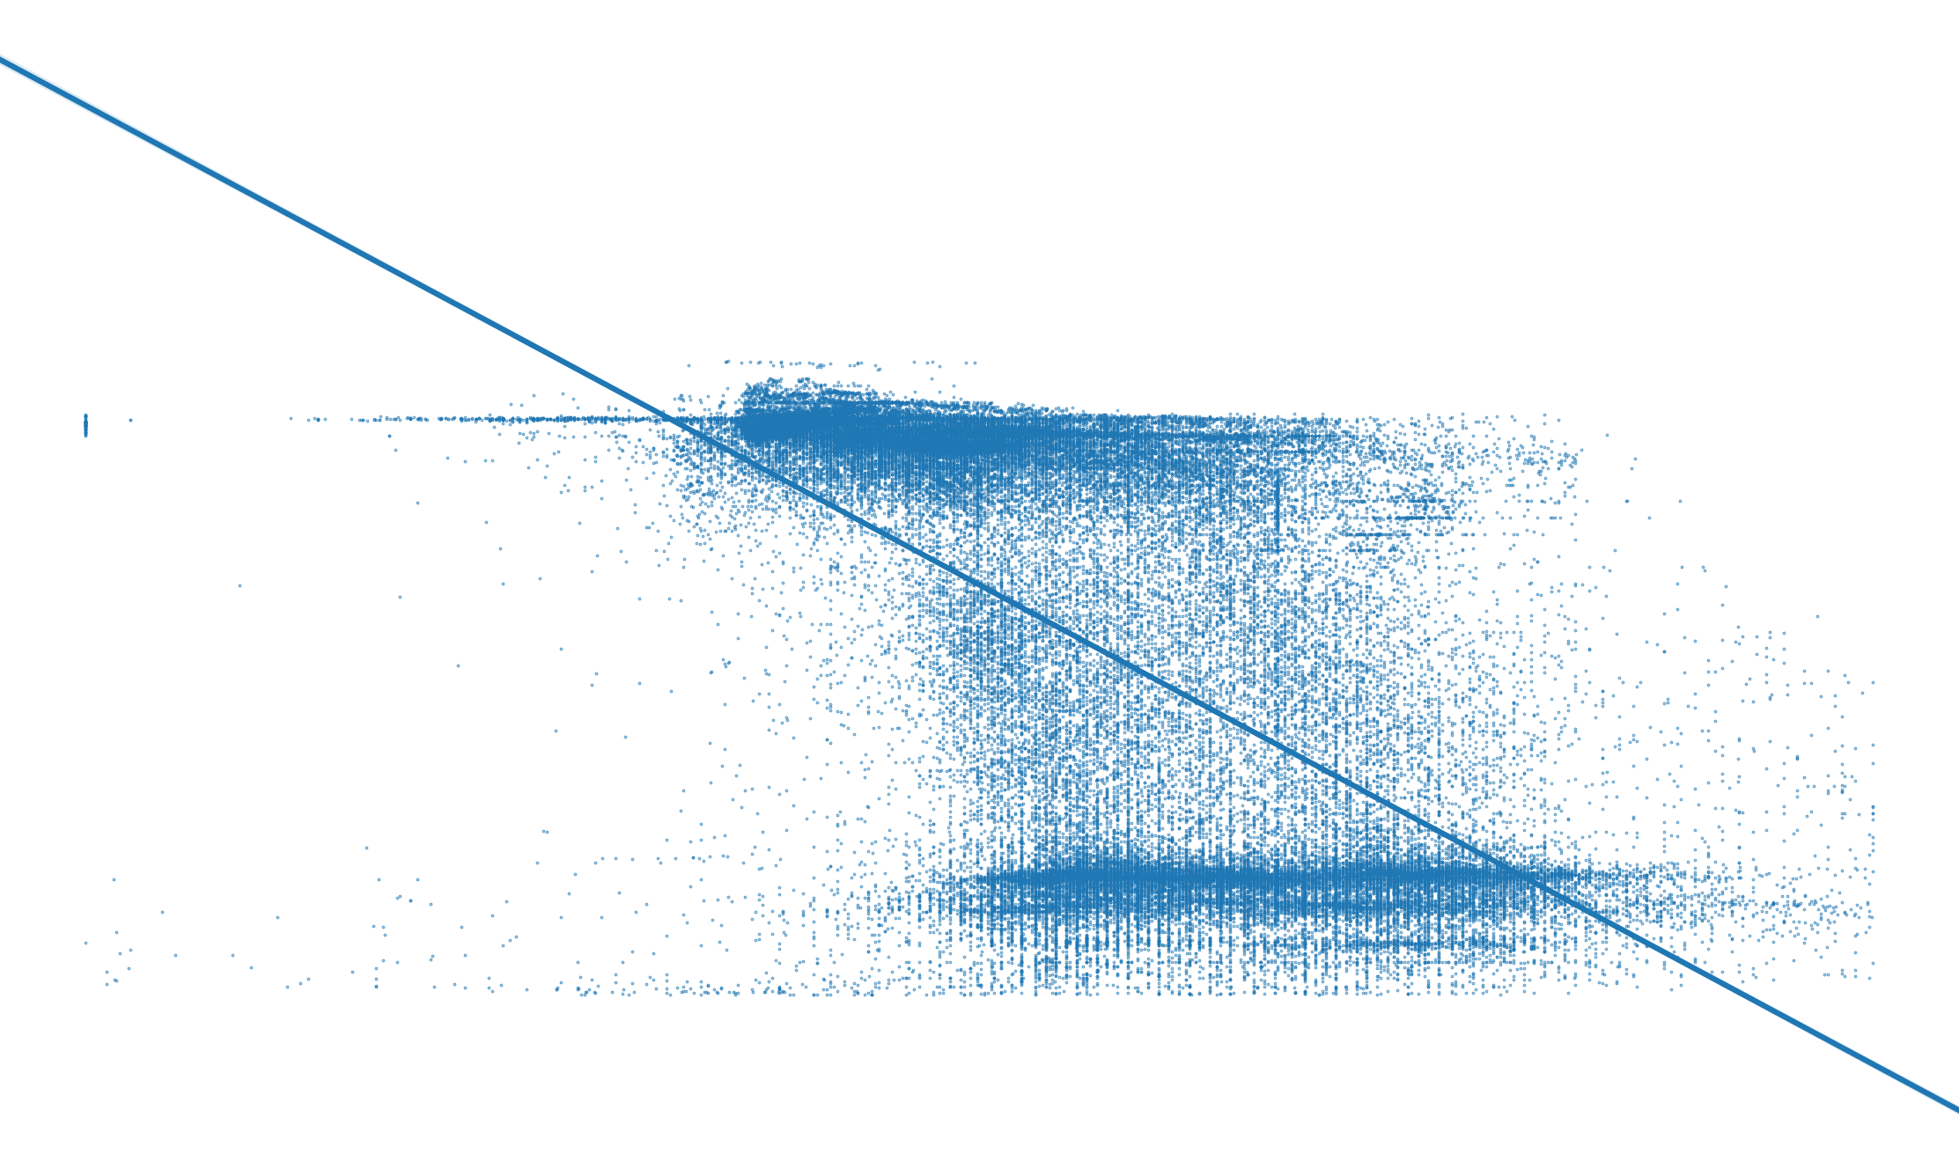
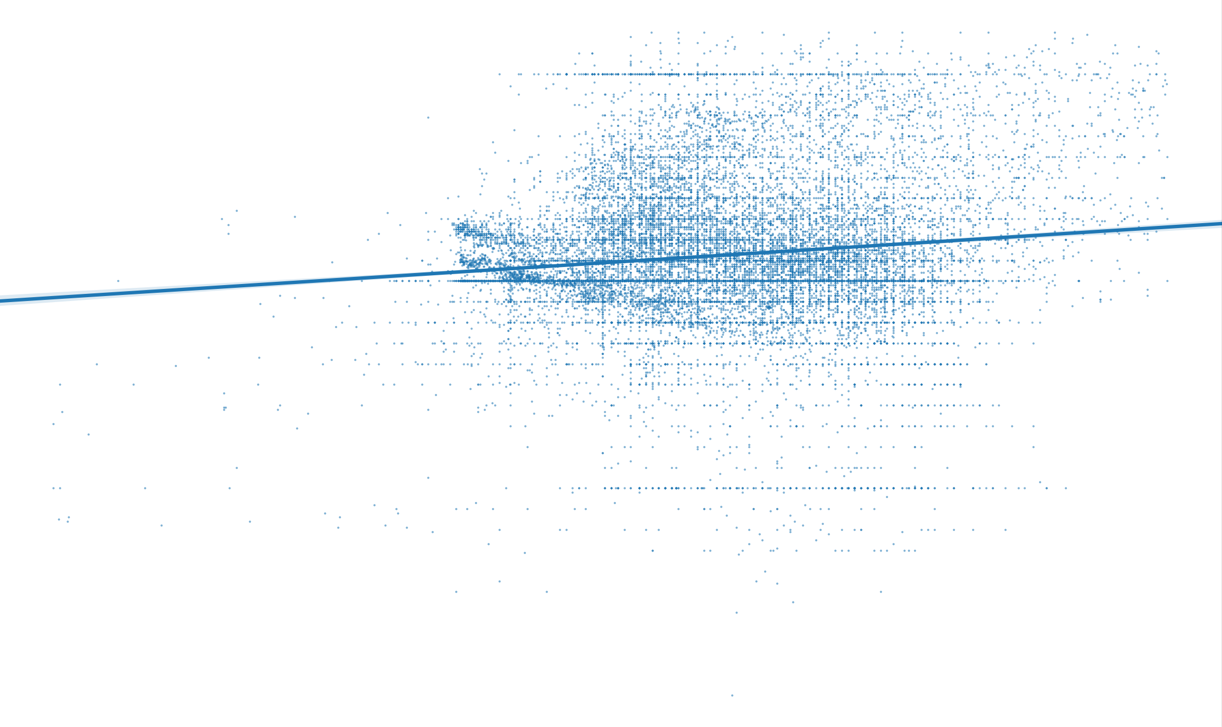
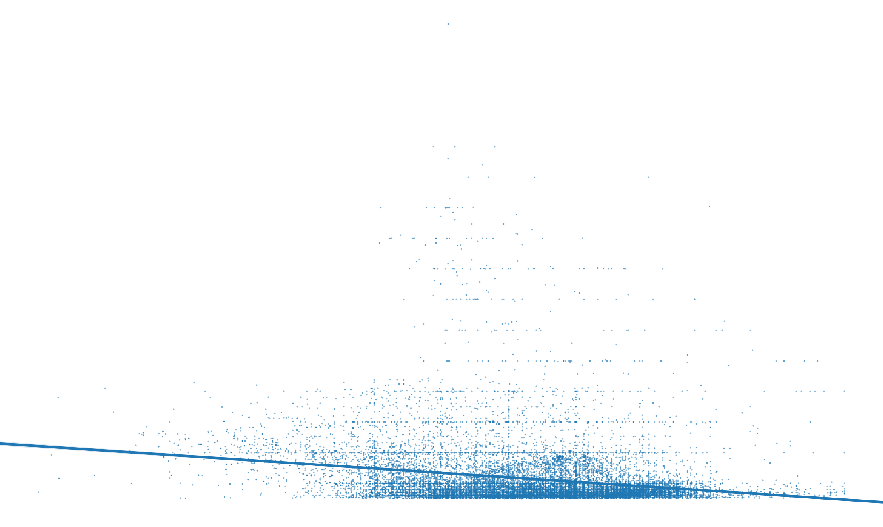

Salinity
pH
Oxygen
Oxygen
Nitrate
Phosphate

Slide 21
How does temperature and other non-bio-measurements are correlated to jellyfish and plankton’s populations?

Slide 22
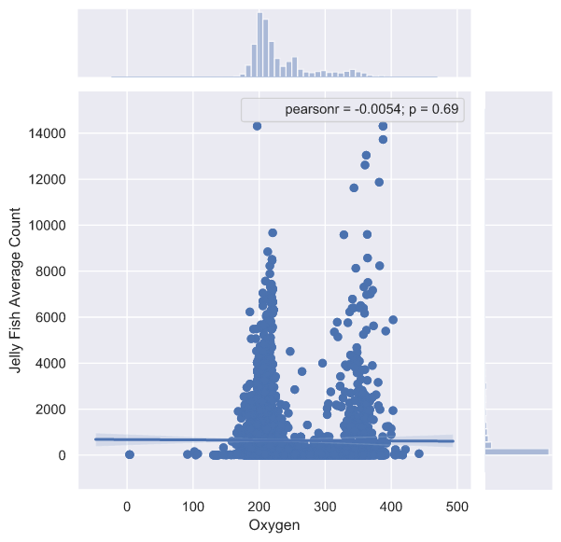
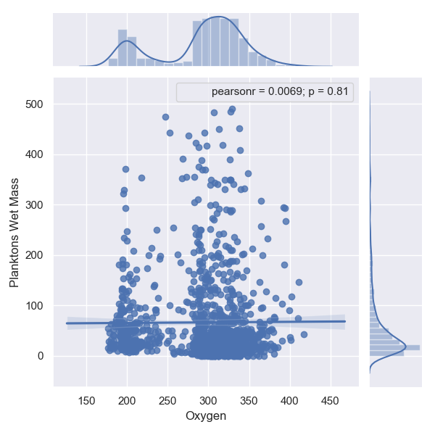
Correlation between oxygen level and Jellyfish and planktons population

Slide 23
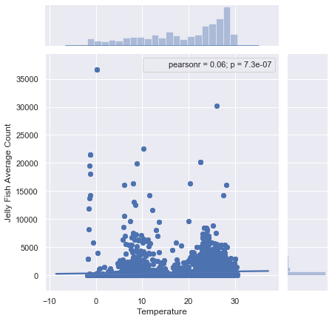
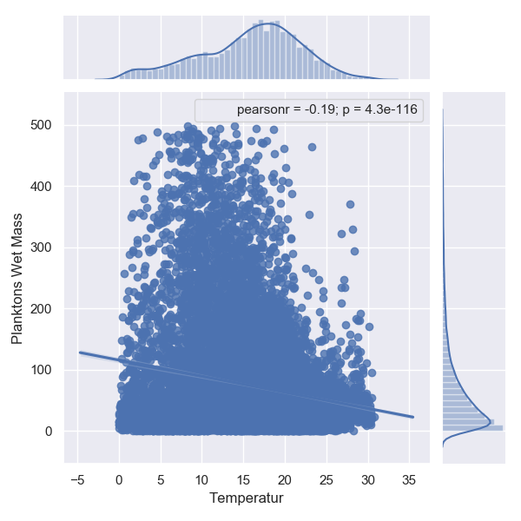
Correlation between temperature and Jellyfish and planktons population

Slide 24
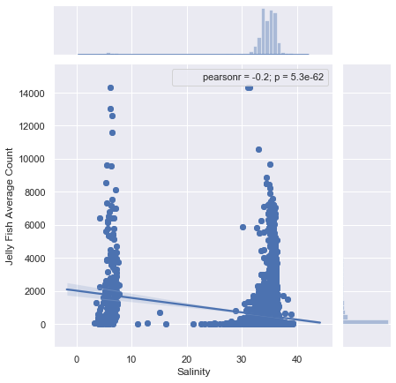
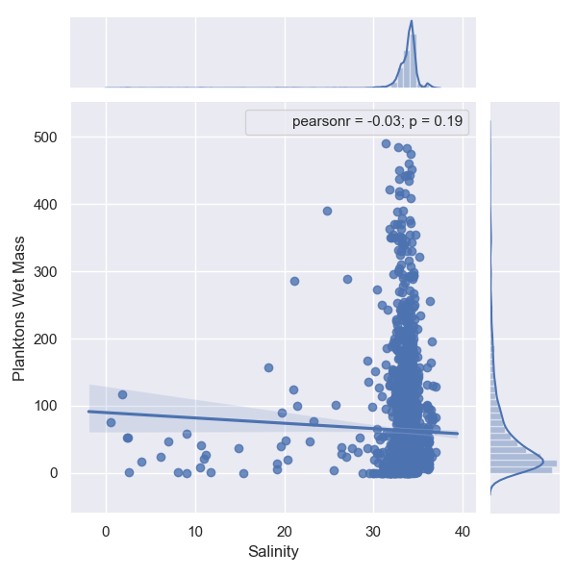
Correlation between salinity and Jellyfish and planktons population

Slide 25
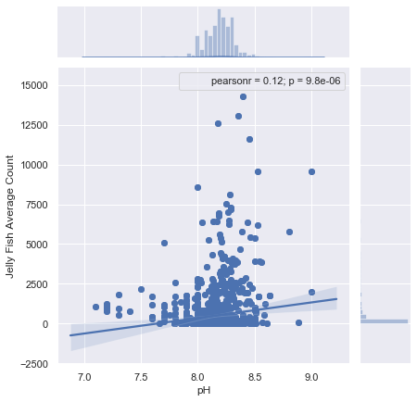
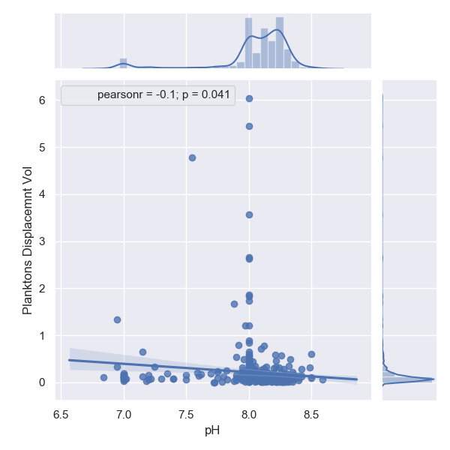
Correlation between pH and Jellyfish and planktons population

Slide 26
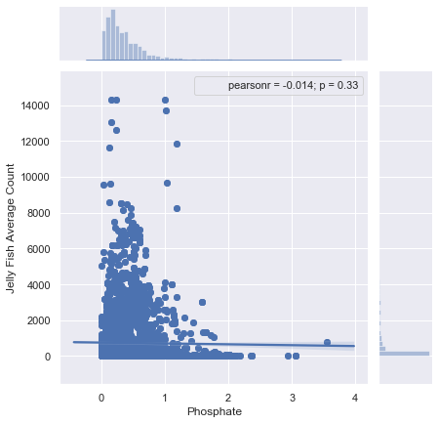
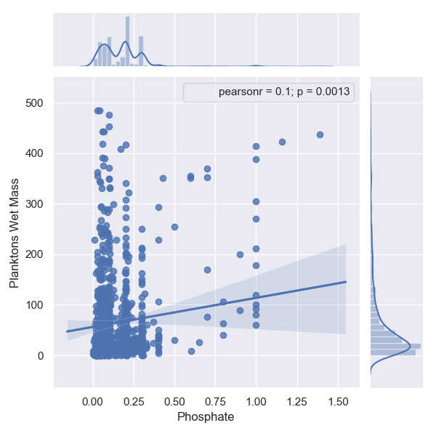
Correlation between phosphate and Jellyfish and planktons population

Slide 27
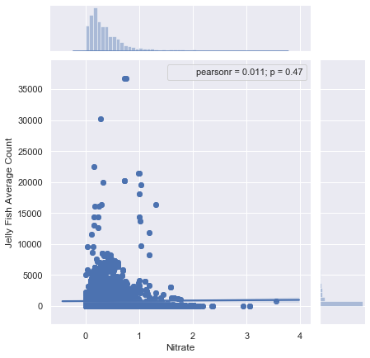
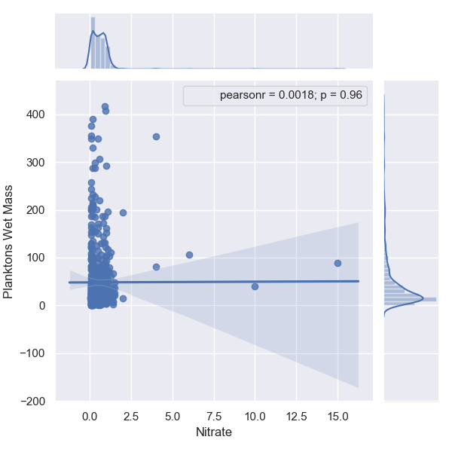
Correlation between nitrate and Jellyfish and planktons population

Slide 28
Temperature affects on jellyfish and planktons
Unlike other ocean species, the warmer temperatures mean longer reproductive periods for jellyfish, as well higher ingestion and growth rates.
Another effect of warmer waters: less oxygen. The saturation of dissolved oxygen decreases as water warms, and for many fish and invertebrate species this makes the water inhospitable. While jellyfish are less abundant in waters with less oxygen, they do appear to be more tolerant of it.

Slide 29
Conclusions
Can our oceans tell us anything about global warming and climate change?
Yes
If yes, where and how is it present?
Globally in different ways
Does it affect biological footprint and marine lives?
We couldn’t see any
Does California experience similar repercussions or trends?
Yes

Slide 30
Thank You! Q&A

